Slide 1
Project Presentation on Phone Book
Submitted By :-
Shubhankar Ranjan – 219302428
Couse Name :- Experiential Learning
Course Code :- DA1001

Slide 2
CONTENTS :-
Software Requirements
Hardware Requirements
Project Type
Uses and Drawback
Header Files
Studied Existing System
Screen Shots of Phone Book Application
Conclusion
Future Prospects
Bibliography

Slide 3
Software Requirements
OS X El Capitan (10.11+)
Windows 7 (with .NET Framework 4.5.2), 8.0, 8.1 and 10, 11 (32-bit and 64-bit)
Linux (Debian): Ubuntu Desktop 16.04, Debian 9
Linux (Red Hat): Red Hat Enterprise Linux 7, CentOS 8, Fedora 24

Slide 4
Hardware Requirements
1.6 GHz or faster processor
1 GB of RAM

Slide 5
Project Type :- Contact Data Management
Project Description:-
This project Phone Book allows us to perform simple Phone Book operations like in our mobile. We can Add, List, Modify, Search and Delete Phone Book related records. Function, File Handling and Data Structure concepts has been extensively used for almost all functions in this project.
Phone Book in C++ is a console application without graphics. The source code is complete and totally error-free. It is compiled in Visual Studio Code with GCC compiler.

Slide 6
Uses of Phone Book :-
Fast Speed Data Processing.
To record the details of various data of users.
It will simplify the task and reduce the paper work.
The system is very user friendly.
Easily accessed by applicants.
Drawback :-
Applicants record must be available within the file system.

Slide 7
Header Files :-
Header Files in this project which is used are :-
#include<iostream>
iostream provides basic input and output services for C++ programs.
#include<windows.h>
windows.h is a Windows-specific header file for the C and C++ programming languages which contains declarations for all of the functions in the Windows API, all the common macros used by Windows programmers, and all the data types used by the various functions and subsystems.

Slide 8
Studied Existing Systems and the Drawback we overcome in these system

Slide 9
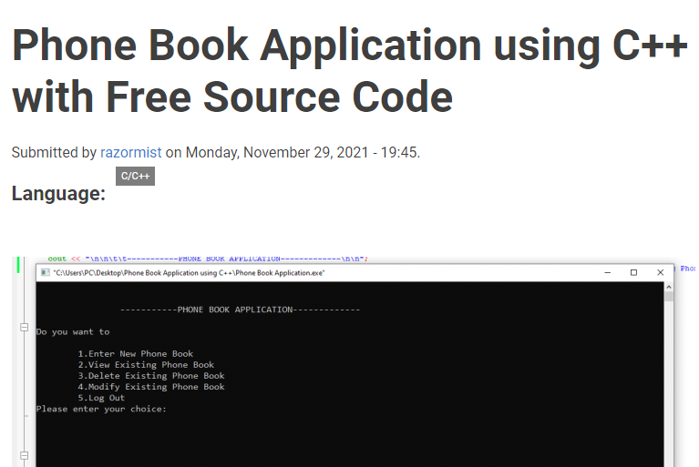
Existing System 1.
Drawback overcome in this system:-
In this system, there is no option to search the existing contact and to delete all the existing contacts and to know the total number of contacts.
Hence, we added the option for search and delete all the existing contacts and to know the total number of contacts in our Phone Book Application.

Slide 10
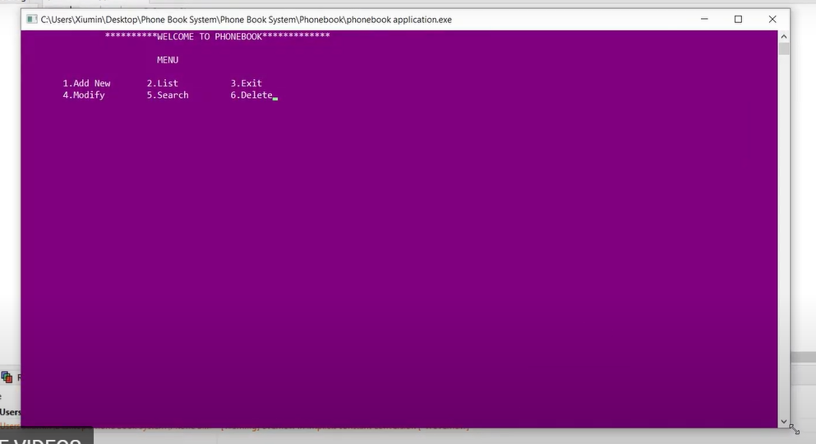
Existing System 2.
Drawback overcome in this system:-
In this system, there is no option to search the existing contact by number and to delete all the existing contacts and to know the total number of contacts.
Hence, we added the option for search by number and delete all the existing contacts and to know the total number of contacts in our Phone Book Application.

Slide 11
Screen Shots of PHONE BOOK APPLICATION

Slide 12
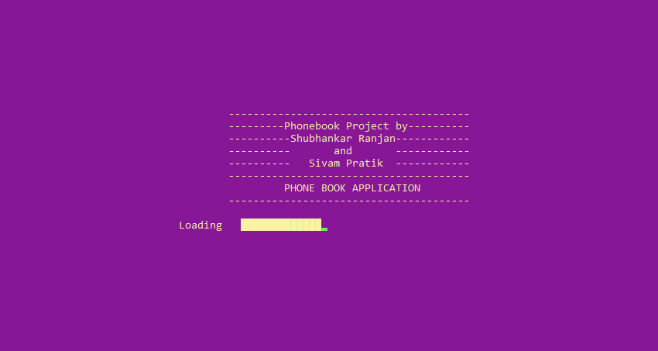
Starting Screen of Phone Book :-

Slide 13
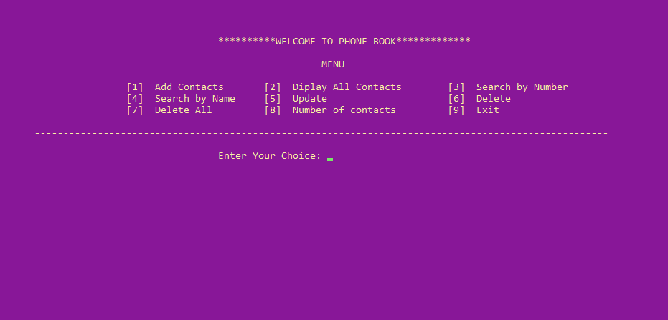
Home Screen of Phone Book :-

Slide 14
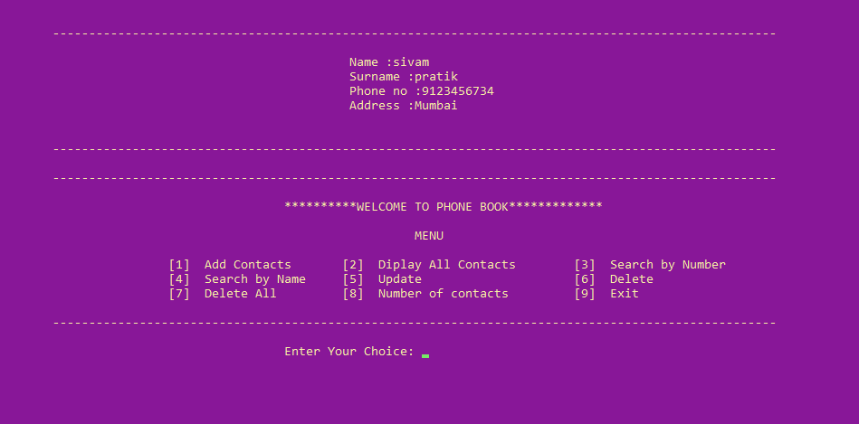
1. Add Contacts :-

Slide 15
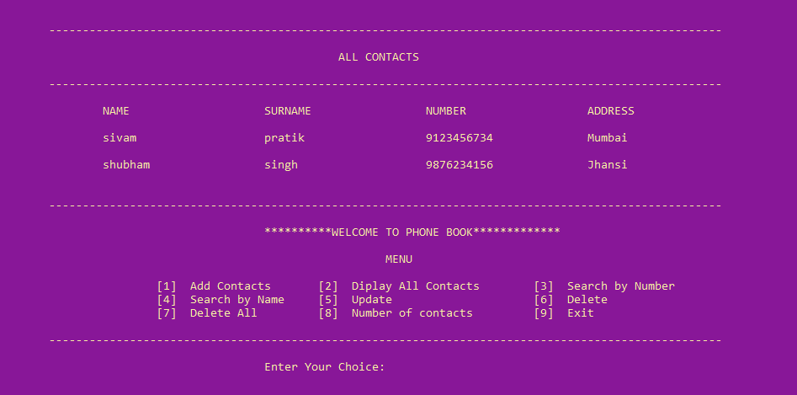
2. Display All Contacts :-

Slide 16
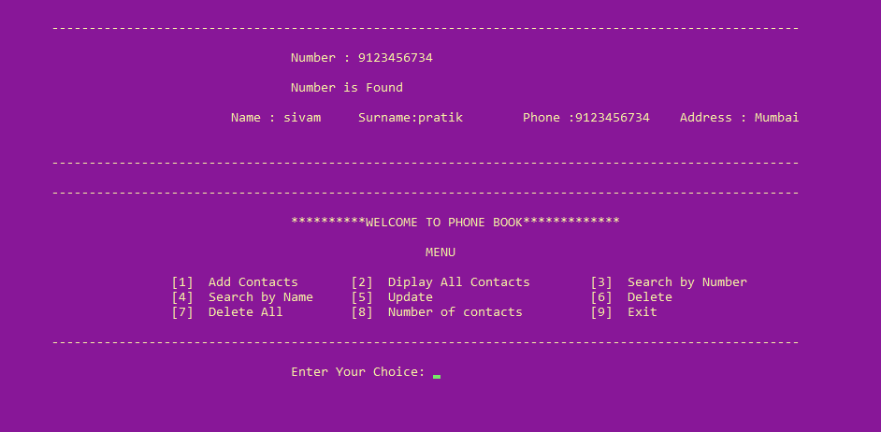
3. Search by Number :-

Slide 17
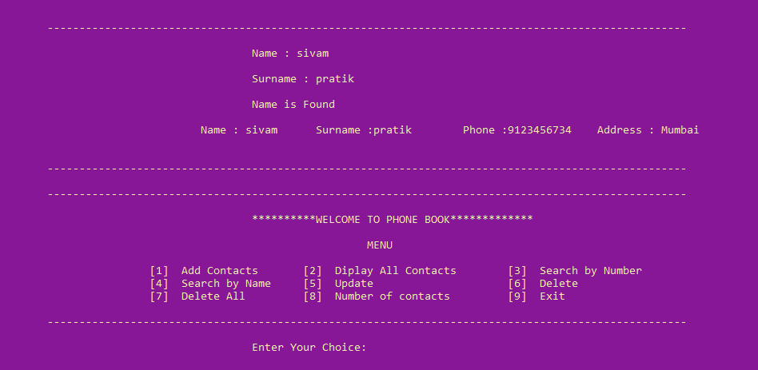
4. Search by Name :-

Slide 18
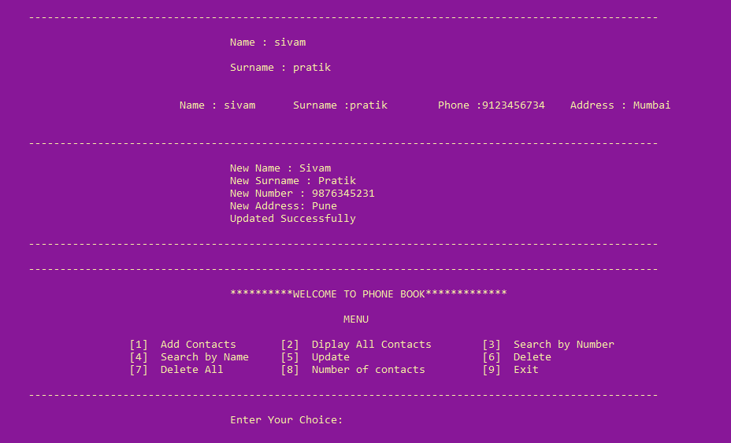
5. Update Contacts :-

Slide 19
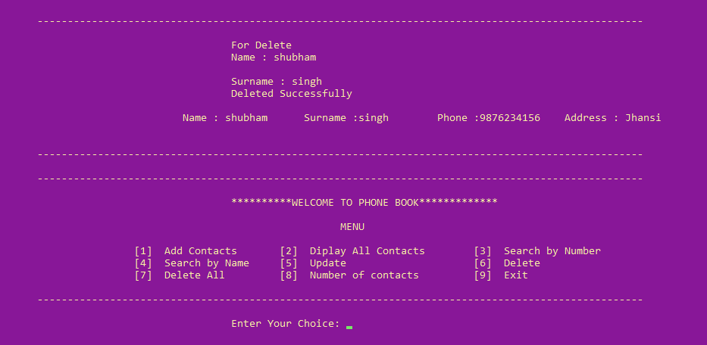
6. Delete Contacts :-

Slide 20
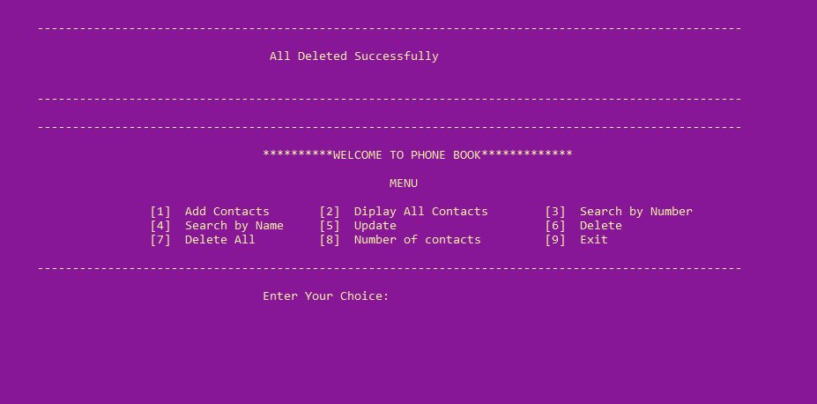
7. Delete All Contacts :-

Slide 21
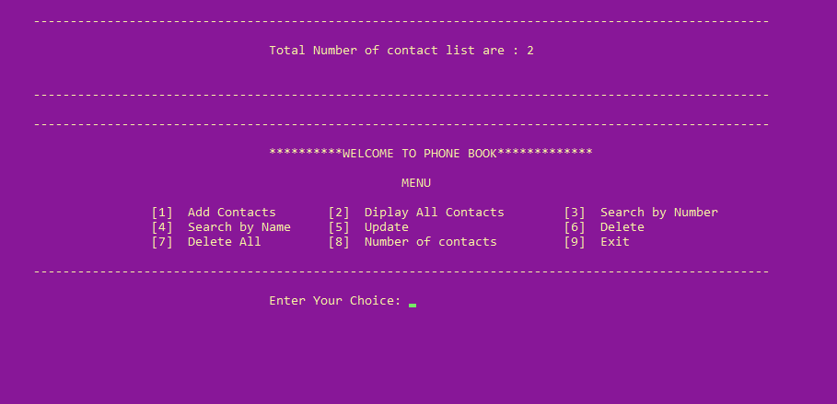
8. Total Number of Contacts :-

Slide 22
CONCLUSION :-
This study has shown that this application is a feasible method to store any contacts than book and papers. The application software has been implemented successfully by using test cases. And the language used is C++ language. This application is used to search, delete, modify and some functions which is used to remember details of contacts more easily.

Slide 23
Future Prospects :-
It is not possible to develop a system that makes all the requirements of the user. User requirements keep changing as the system is being used. Some of the future enhancements that can be done to this system are:
As the technology emerges, it is possible to upgrade the system and can be online.
GPS can be added.
Based on the future security issues, security can be improved using emerging technologies.
Online with Offline Mode.

Slide 24
BIBLIOGRAPHY :-
Wikipedia, Website: https://en.wikipedia.org/wiki/Telephone_directory
Yashavant P. Kanetkar, Let us C++ (2020), 17th Edition, BPB PUBN
GeeksforGeeks, Website: https://www.geeksforgeeks.org/c-plus-plus/
Code with Harry, Website: https://www.codewithharry.com/videos/cpp-tutorials-in-hindi-1/

Slide 25
THANK YOU

